Slide 1
Implementing Frailty Screening & Management in Primary Care using the Guidance Document
April 2024

Slide 2
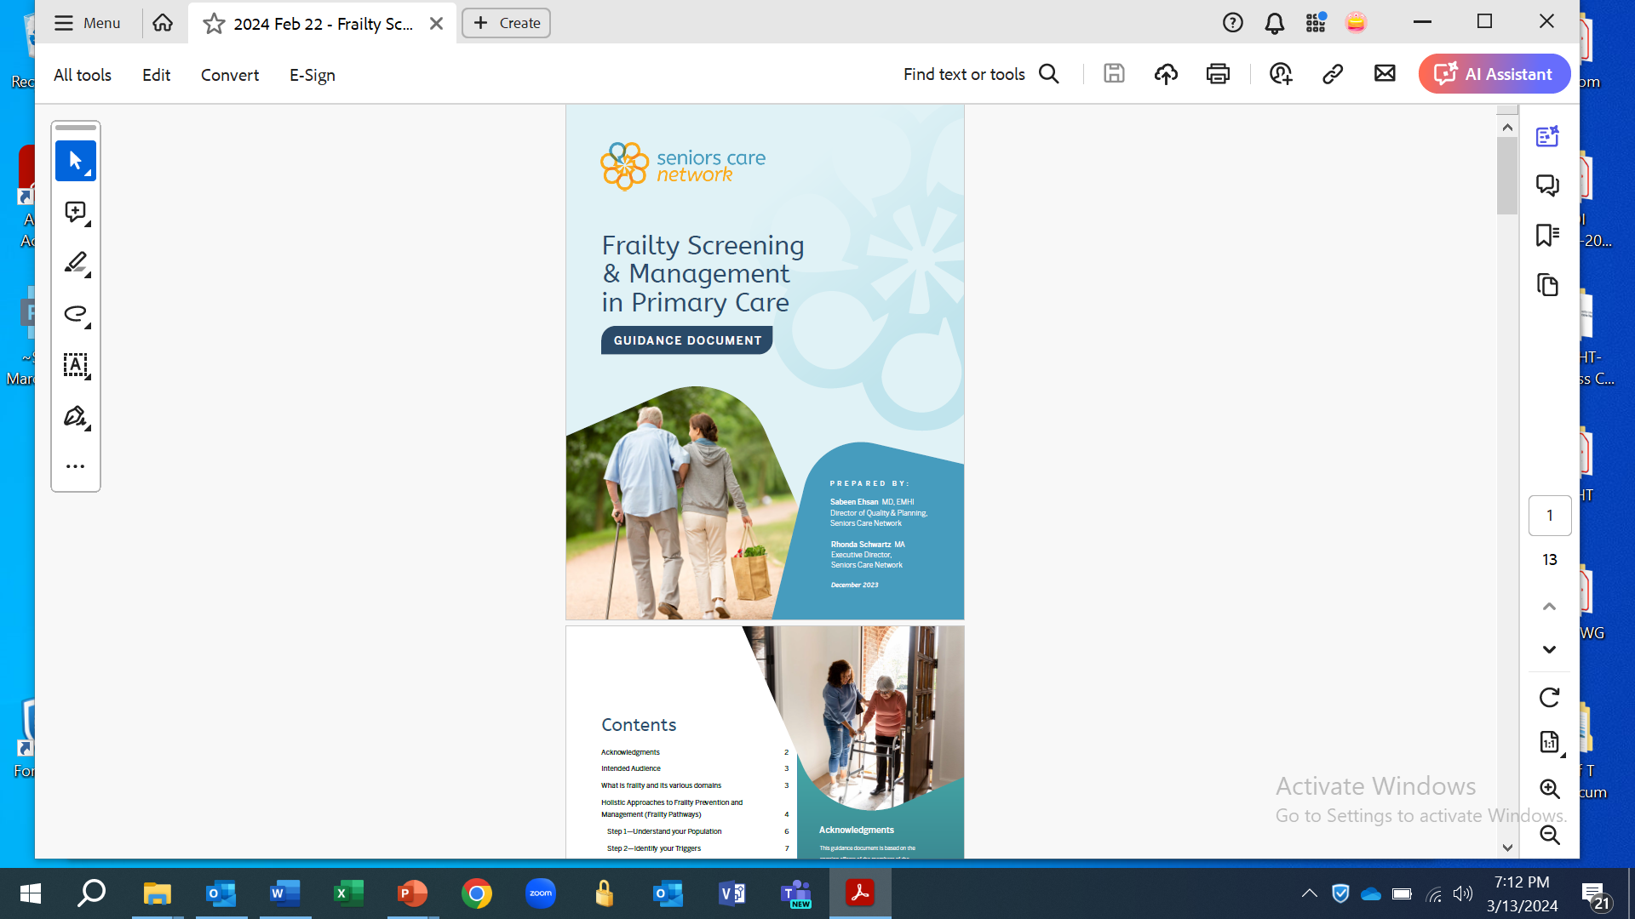
Intent
The presentation summarizes the 5-step approach detailed in the Frailty Screening & Management in Primary Care Guidance Document

Slide 3
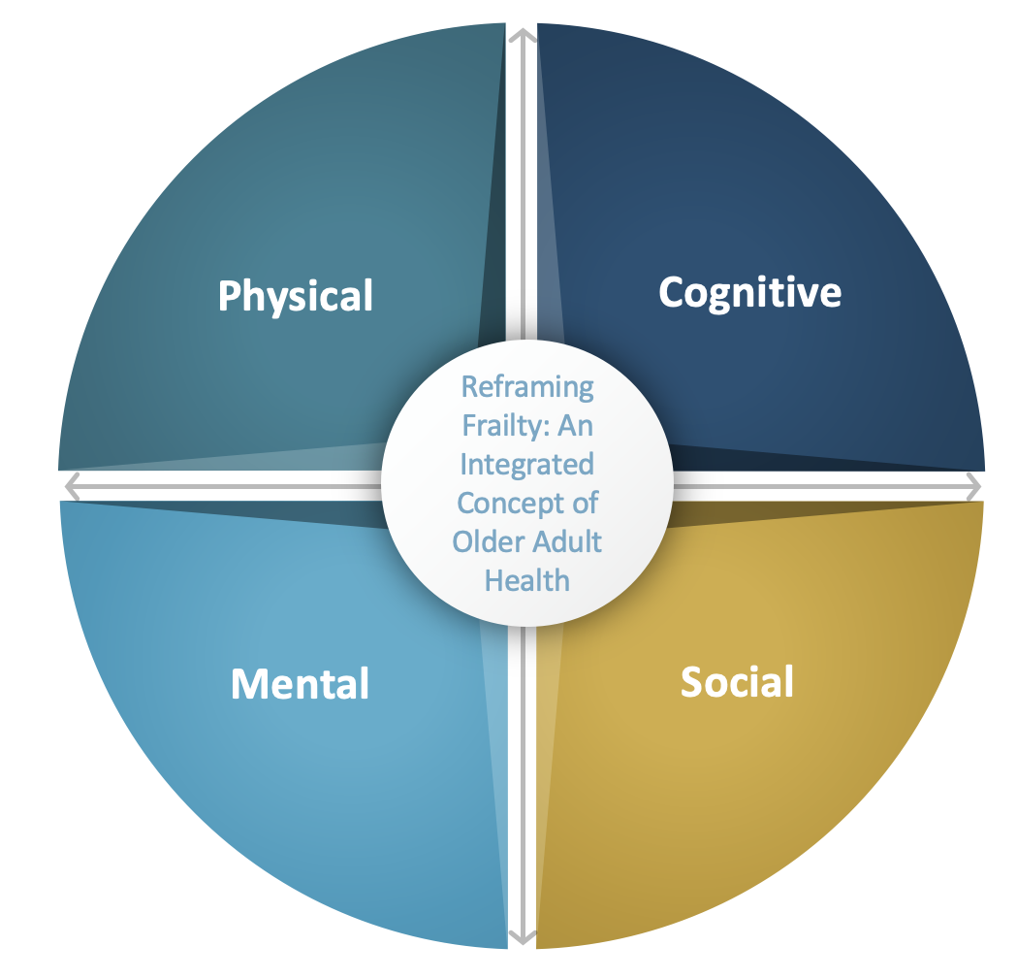
What is Frailty?
A state of increased vulnerability, with reduced physical reserve and loss of function across multiple body systems¹.
  Predicts death, heightened vulnerability, institutionalization and a reduced quality of life¹.
The concepts of frailty must include the physical, cognitive, mental, and social health of older adults and their care partners, and the interaction and integration of these four domains².
Source: PGLO 2023
¹ Canadian Frailty Network, 2016
² OCAW, 2023
Notes:
A comprehensive approach in describing the concept of frailty is recommended.

Slide 4
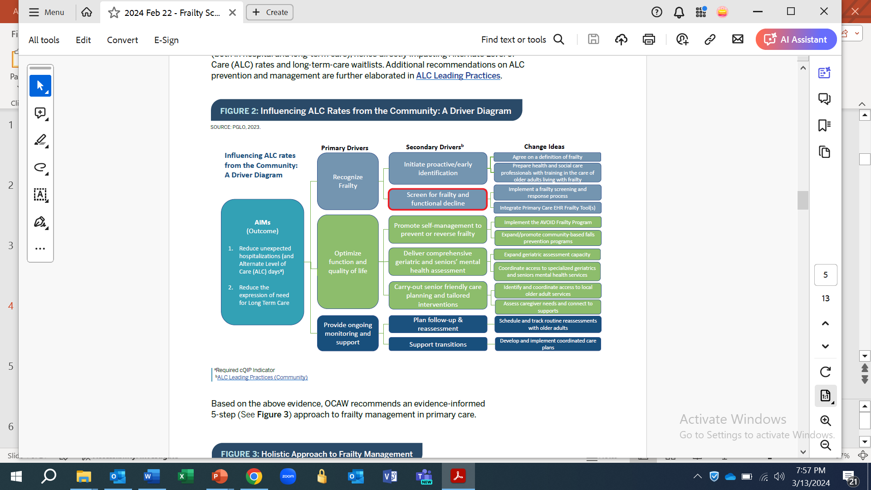
Frailty Pathways and their benefit
Standardized approaches to prevention, identification, assessment, and management (treatment and interventions) to support older adults with living in the community, and/or maintaining their function and independence.
Notes:
Supporting older adults with complex needs requires holistic, coordinated, and integrated approaches to promote independence and quality of life, and prevent adverse events also sometimes referred to as Frailty pathways. PGLO 2022.
Frailty Pathways are standardized approaches to prevention, identification, assessment, and management (treatment and interventions) to support older adults with living in the community, and/or maintaining their function and independence.
As depicted in this Driver Diagram, proactive recognition and management of frailty contributes towards reduction in unexpected hospitalizations that in-turn contribute towards reduction in ALC rates and the need for LTC placements.
Entry into a frailty pathway can happen through various settings including primary care.

Slide 5
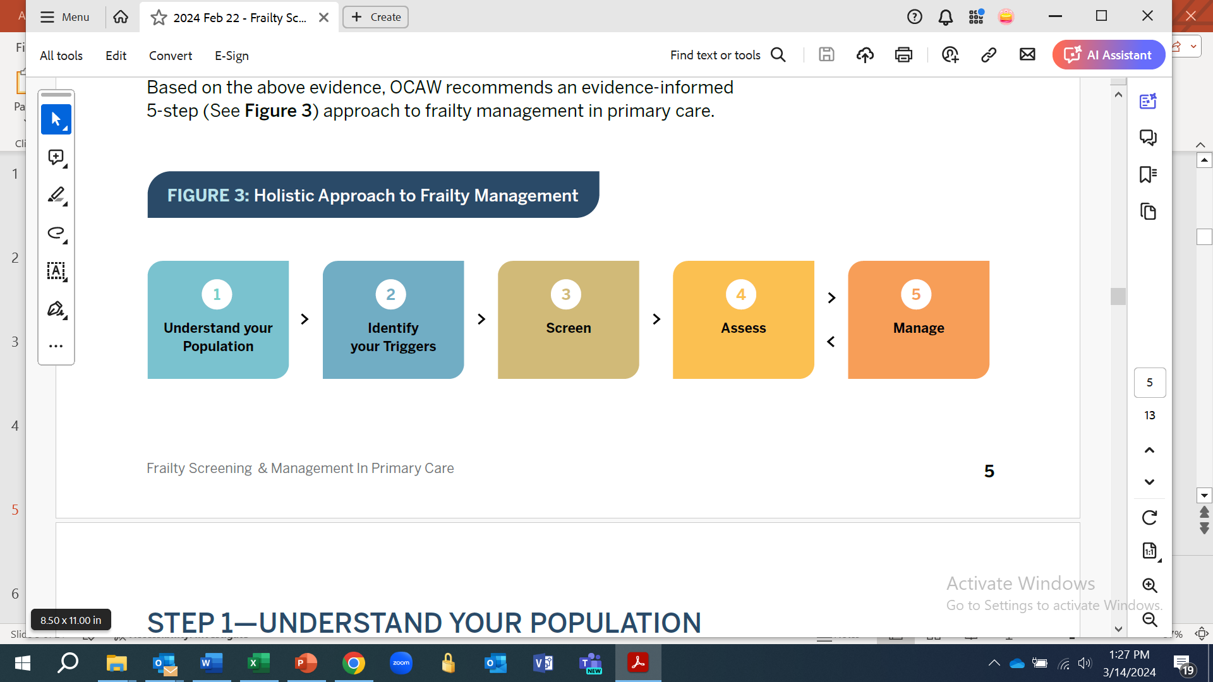
Frailty Management in Primary Care
OCAW recommends a 5-step, evidence-informed approach to implement frailty screening, assessment and management in Primary Care.

Slide 6
Review administrative data sources such as the Inspire PHC data and the PGLO Frailty Estimates to understand the prevalence of frailty at a population level.
Consider conducting chart reviews using the sample chart review tool to better understand the characteristics/needs of the older adult clientele at the practice.
Notes:
Please review Appendix 1 in the Guidance Document for tips regarding the interpretation of administrative data.

Slide 7
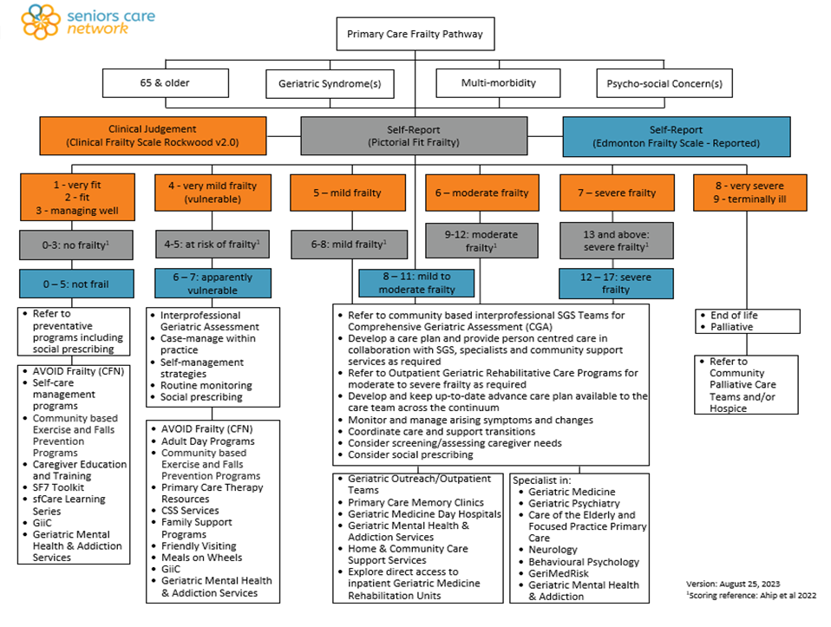
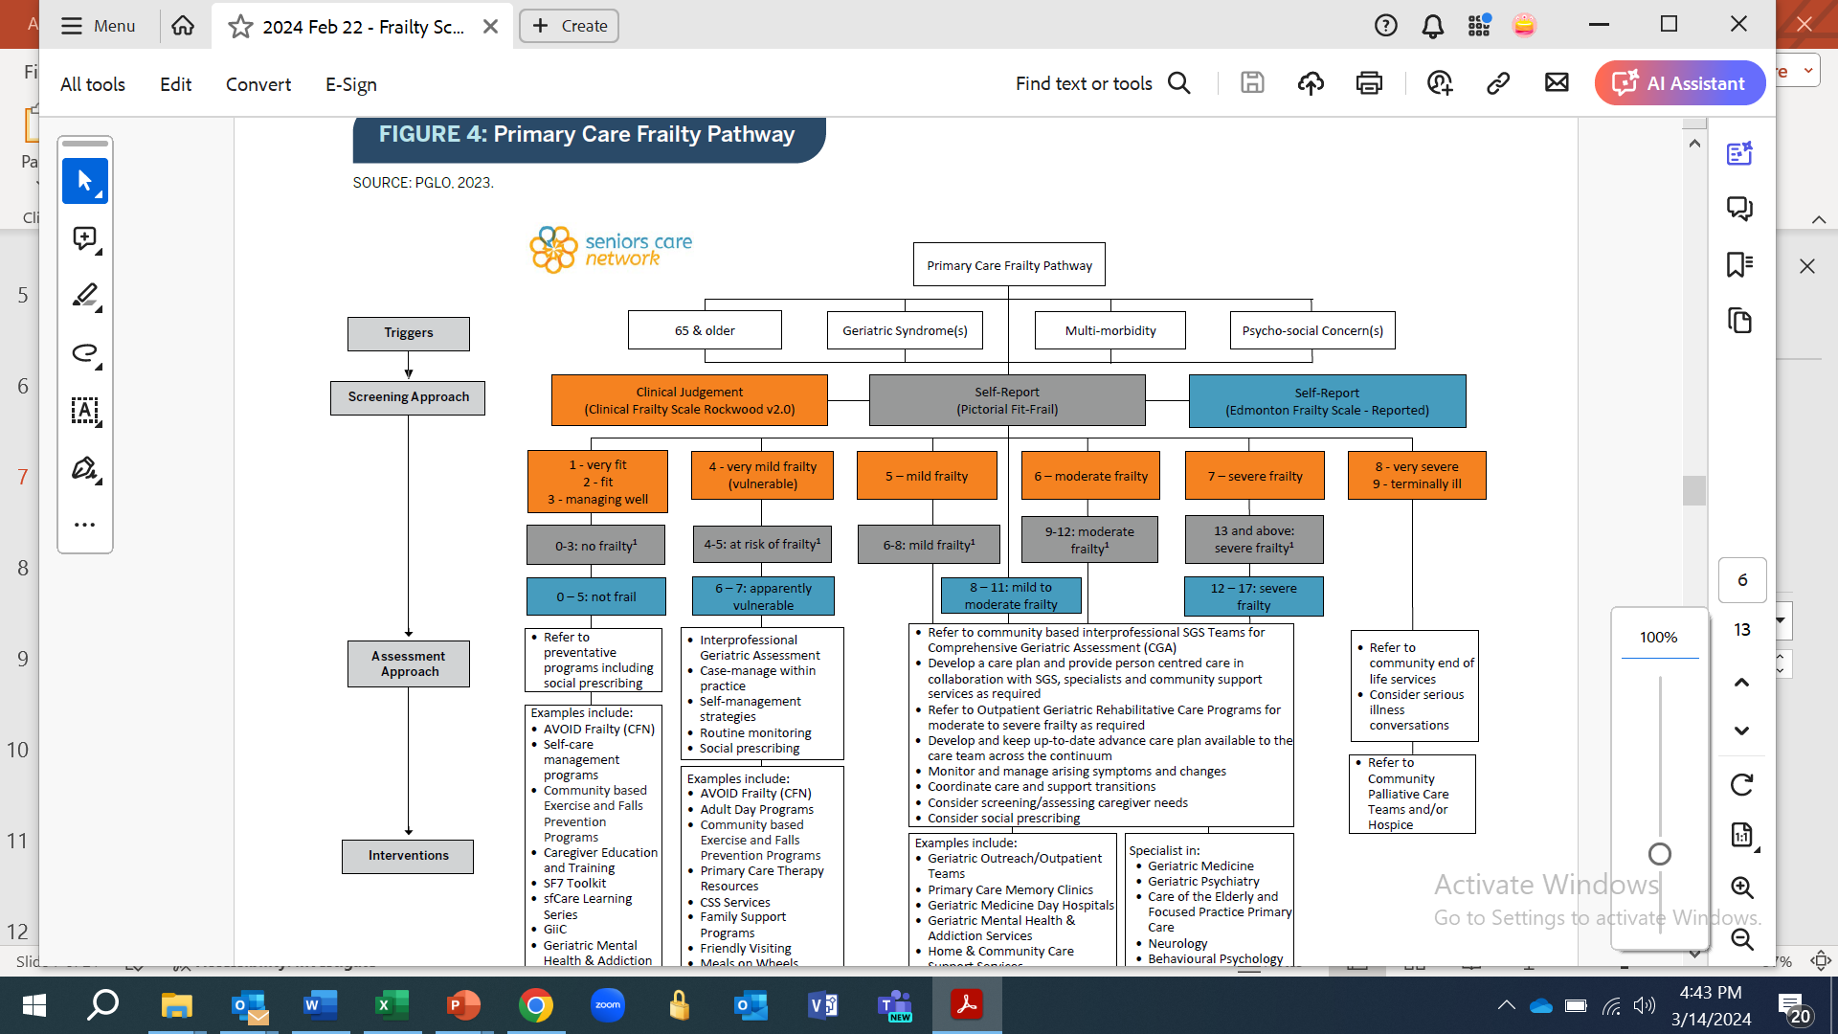
Frailty Pathway to guide Steps 2 to 5

Slide 8
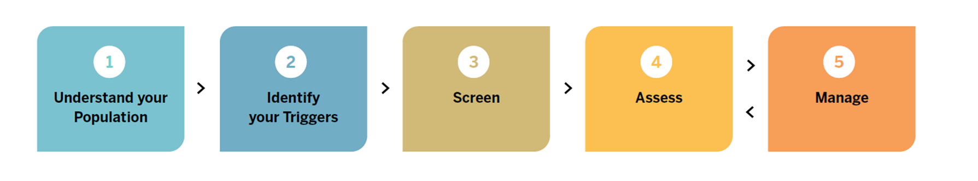
As depicted in the Frailty Pathway (slide 7), one or more of the following triggers can be used to identify individuals to be screened for the presence of frailty:
• Age 65 & older
• Presence of Geriatric Syndrome(s)
• Multi-morbidity
• Psycho-social concerns.
Notes:
Based on the results of administrative data and/or practice-level chart reviews higher age cut-offs may be used

Slide 9
A rapid review of literature and reference resources was conducted to identify validated frailty screening tools for primary care settings
The 3 shortlisted tools i.e., the Clinical Frailty Scale, the Pictorial Fit-Frail Scale, and the Reported Edmonton Frail Scale are shown in the Frailty Pathway. These three tools are comprehensive and cover all 4 domains of frailty
Each individual provider should select ‘the one’ tool that meets their needs and preferences. If the use of a screening tool other than the ones recommended above is being examined, it is advised to review the tool considering the 8 criteria detailed in the Guidance document.
Notes:
The 8 criteria used, and results of the review are summarized in the Guidance Document

Slide 10
Screening Approach

Slide 11
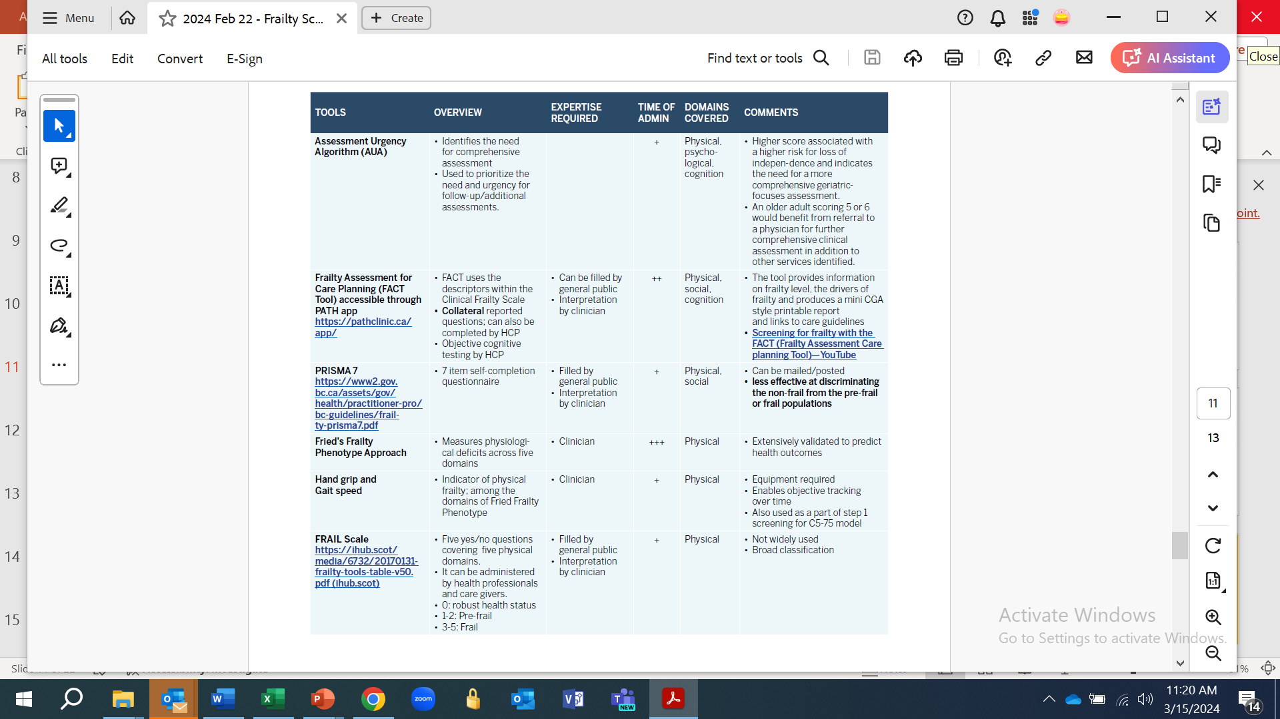
Other screening tools for consideration

Slide 12
The need for further assessment will be guided by the presence and degree of frailty, and clinical judgement
The Frailty Pathway identifies the role of preventative programs, primary care, interprofessional primary care teams and specialized services (geriatrics, mental health, palliative care, etc.) based on results of the screening.

Slide 13
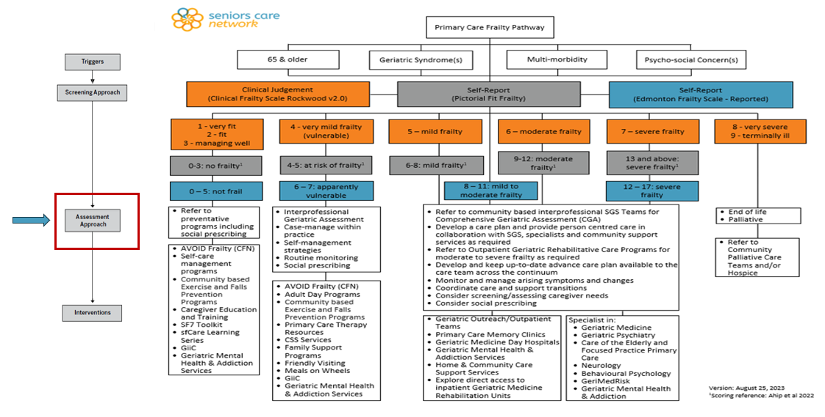

Slide 14
Refer to the interventions section of the Frailty Pathway to appropriately manage patients across the frailty spectrum
The bottom rectangle on left most side highlights some upstream approaches for individuals who are not frail or at risk for frailty
The right side depicts more downstream approaches with the explicit role of Specialized Geriatric Services and Geriatric Mental Health and Addiction Services for individuals that are more advanced on their frailty journey.

Slide 15
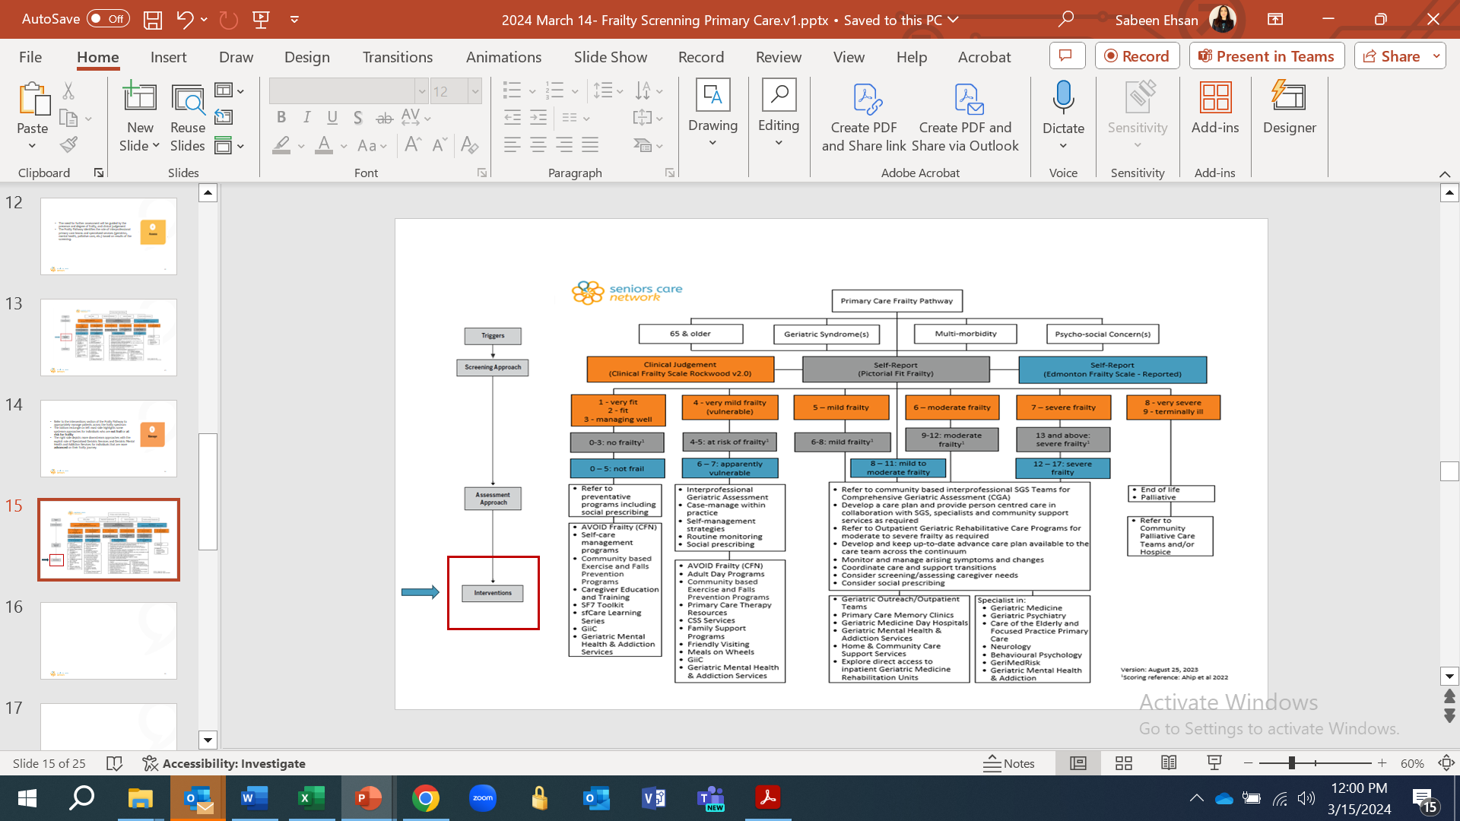
Notes:
As depicted here, the left rectangles identify preventative and supportive services, such as, coaching/education programs built on the AVOID Frailty framework, fall prevention and exercise programs, Adult Day Programs, etc.
The right-sided rectangles identify the role of specialized services and clinicians.
These interventions should be modified and refined based on the availability of local and sub-regional community and specialized resources in your jurisdiction.

Slide 16
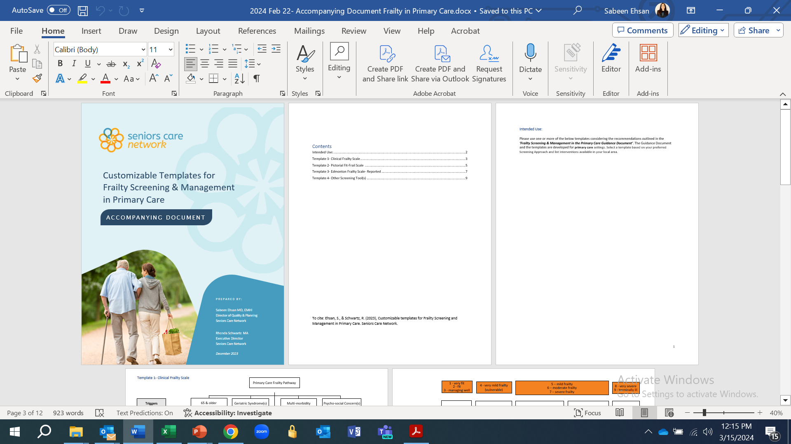
Customizable Templates
Once the forementioned 5-steps are finalized, the providers can leverage ‘Customizable Templates for Frailty Screening and Management in Primary Care’ to tailor the recommended practices in accordance with their preferences and service & program availability in their local area/region

Slide 17
Things to consider

Slide 18
Early frailty identification and mitigation leads to ALC avoidance
All sectors/providers can play a pivotal role in frailty prevention and management
Identify and involve key stakeholders (PCPs, specialists, CSS partners) early
Use a staged and guided approach to model refinement: 1) pilot, 2) evaluate, 3) 3) improve/expand
Leverage digital enablers (electronic screening tools, online referral forms, etc.) to facilitate implementation

Slide 19
www.seniorscarenetwork.ca

